Slide 1

Session - 7

Slide 2
Content
Xaml Basics
Xaml Compilation
Xaml Namespaces
Xaml Markup Extensions
Bindable Properties
Attached Properties
Resource Dictionaries
Styles

Slide 3
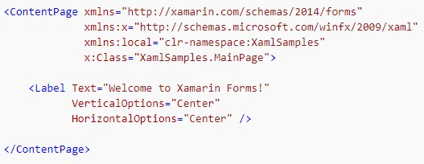
Xaml Basics
XAML is mostly used to define the visual contents of a page.
A XAML file is always associated with a C# code file that provides code support for the markup.
Together, these two files contribute to a new class definition that includes child views and property initialization.
Within the XAML file, classes and properties are referenced with XML elements and attributes, and links between the markup and code are established.
MainPage.xaml

Slide 4
The two XML namespace ( xmlns) declarations refer to URIs, the first seemingly on Xamarin’s web site and the second on Microsoft’s
The second namespace declaration defines a prefix of x. This is used for several elements and attributes that are intrinsic to XAML itself and which are supported by other implementations of XAML.
The local namespace declaration allows you to access other classes from the PCL project.
The x:Class attribute specifies a fully qualified .NET class name: the MainPage class in the XamlSamples namespace.

Slide 5
x namespace attributes supported by Xamarin
x:Arguments - Specifies constructor arguments for a non-default constructor, or for a factory method object declaration.
x:Class - Specifies the namespace and class name for a class defined in XAML. Note that this construct can only appear in the root element of a XAML file.
x:FactoryMethod - Specifies a factory method that can be used to initialize an object.
x:Key - Specifies a unique user-defined key for each resource in a ResourceDictionary. The key's value is used to retrieve the XAML resource, and is typically used as the argument for the StaticResource markup extension.
x:Name - Specifies a runtime object name for the XAML element. Setting x:Name is similar to declaring a variable in code.
x:TypeArguments - Specifies the generic type arguments to the constructor of a generic type.

Slide 6
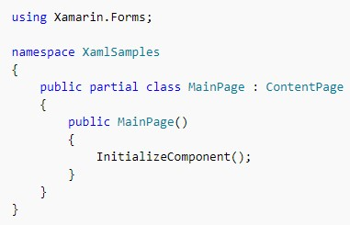
MainPage.xaml.cs file is Partial
Build your Project and Goto obj\debug folder,you’ll find a file named XamlSamples.MainPage.xaml.g.cs
So the resultant display is prepared from :
XamlSamples.MainPage.xaml.cs
XamlSamples.MainPage.xaml.g.cs
InitializeComponent :
MainPage class constructor will call the InitializeComponent
Then calls the LoadFromXaml method that extracts the XAML file (or its compiled binary) from the PCL
LoadFromXaml initializes all the objects defined in the XAML file, connects them all together in parent-child relationships, attaches event handlers defined in code to events set in the XAML file, and sets the resultant tree of objects as the content of the page.

Slide 7
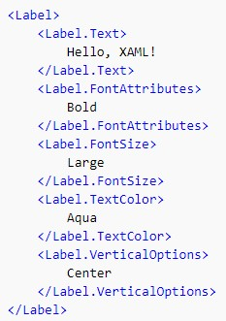
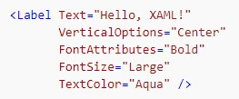
Setting properties of class as xaml attributes

Slide 8
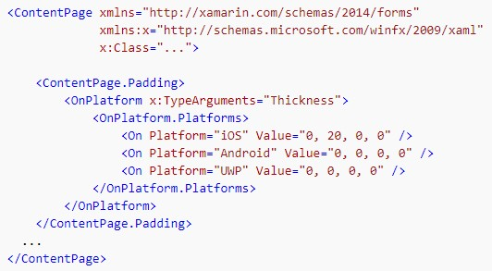

Platform difference with OnPlatfrom

Slide 9
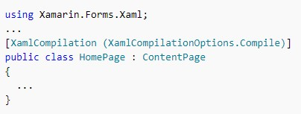
Xaml Compilation
XAML can be optionally compiled directly into intermediate language (IL) with the XAML compiler (XAMLC).
XAMLC offers a number of a benefits:
Performs compile-time checking of XAML, notifying the user of any errors.
Removes some of the load and instantiation time for XAML elements.
Helps to reduce the file size of the final assembly by no longer including .xaml files.
XAMLC is disabled by default to ensure backwards compatibility.
It can be enabled at both the assembly and class level by adding the XamlCompilation attribute.
Note: The XamlCompilation attribute and the XamlCompilationOptions enumeration reside in the Xamarin.Forms.Xaml namespace, which must be imported to use them.

Slide 10

Xaml Namespaces
clr-namespace: or using: – The CLR namespace declared within the assembly that contains the types to expose as XAML elements. This keyword is required.
assembly= –
Assembly that contains the referenced CLR namespace.
This value is the name of the assembly, without the file extension.
The path to the assembly should be established as a reference in the project file that contains the XAML file that will reference the assembly.
This keyword can be omitted if the clr-namespace value is within the same assembly as the application code that's referencing the types.

Slide 11
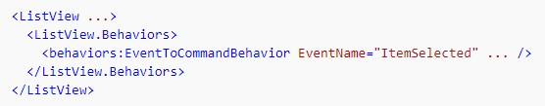

Slide 12
Xaml Markup Extension
XAML markup extensions help enhance the power and flexibility of XAML by allowing element attributes to be set from a variety of sources.
Several XAML markup extensions are part of the XAML 2009 specification.
These appear in XAML files with the customary x namespace prefix:
x:Static – reference static properties, fields, or enumeration members.
x:Reference – reference named elements on the page.
x:Type – set an attribute to a System.Type object.
x:Array – construct an array of objects of a particular type.
x:Null – set an attribute to a null value.

Slide 13
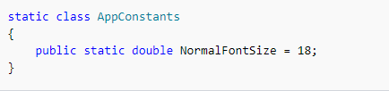
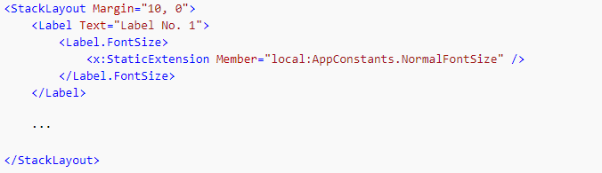
x:Static Markup Extension
The x:Static markup extension is supported by the StaticExtension class. The class has a single property named Member of type string that you set to the name of a public constant, static property, static field, or enumeration member.
Several ways to use the x:Static markup extension :-

Slide 14



Slide 15
x:Reference Markup Extension
The x:Reference markup extension is supported by the ReferenceExtension class. The class has a single property named Name of type string that you set to the name of an element on the page that has been given a name with x:Name. This Name property is the content property of ReferenceExtension, so Name= is not required when x:Reference appears in curly braces.
Uses of x:Reference with data bindings :
It is used to set the Source property of the Binding object
It is used to set the BindingContext property for two data bindings

Slide 16
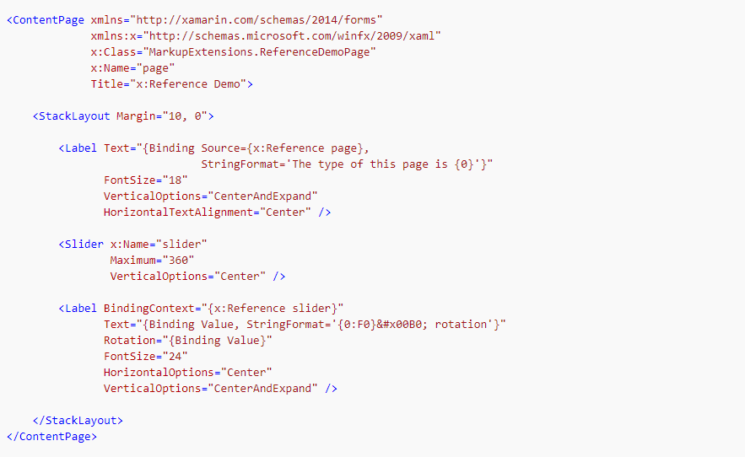
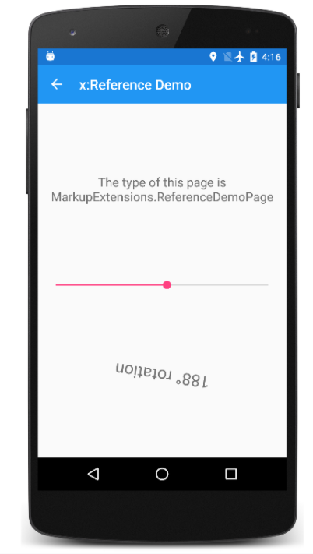

Slide 17
x:Type Markup Extension
The x:Type markup extension is the XAML equivalent of the C# typeof keyword.
It is supported by the TypeExtension class, which defines one property named TypeName of type string that is set to a class or structure name.
The x:Type markup extension returns the System.Type object of that class or structure.
Properties that have arguments of type Type :
the TargetType property of Style
the x:TypeArguments attribute used to specify arguments in generic classes
x:Type is required with the x:Array markup extension

Slide 18
x:Array Markup Extension
The x:Array markup extension allows you to define an array in markup. It is supported by the ArrayExtension class, which defines two properties:
Type of type Type, which indicates the type of the elements in the array.
Items of type IList, which is a collection of the items themselves. This is the content property of ArrayExtension.
The x:Array markup extension itself never appears in curly braces. Instead, x:Array start and end tags delimit the list of items. Set the Typeproperty to an x:Type markup extension.

Slide 19
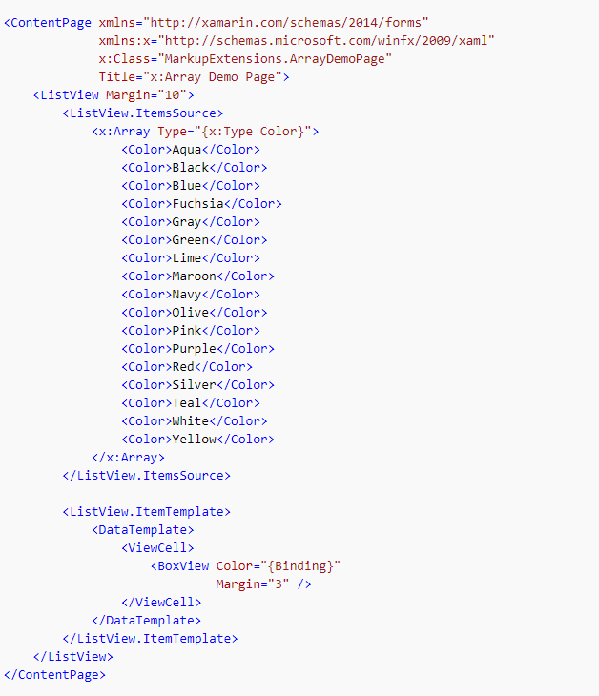
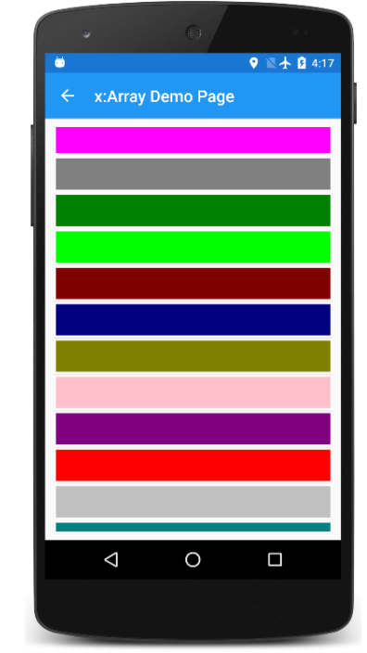

Slide 20
Ways to specify the individual Color items in array
<x:Static Member="Color.Blue" />
<StaticResource Key="myColor" />
<local:HslColor H="0.5" S="1.0" L="0.5" />

Slide 21
x:Null Markup Extension
The x:Null markup extension is supported by the NullExtension class.
It has no properties and is simply the XAML equivalent of the C# nullkeyword.

Slide 22
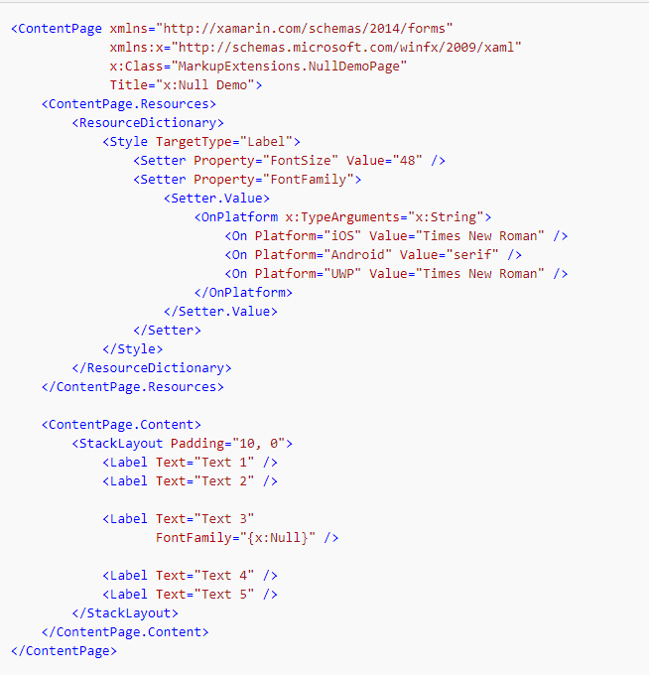
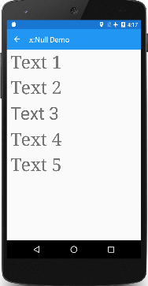

Slide 23
Creating XAML Markup Extension
To define custom XAML markup extensions by deriving from IMarkupExtension or IMarkupExtension<T>. Use the generic form if the markup extension obtains a value of a particular type. This is the case with several of the Xamarin.Forms markup extensions:
TypeExtension derives from IMarkupExtension<Type>
ArrayExtension derives from IMarkupExtension<Array>
DynamicResourceExtension derives from IMarkupExtension<DynamicResource>
BindingExtension derives from IMarkupExtension<BindingBase>
ConstraintExpression derives from IMarkupExtension<Constraint>

Slide 24
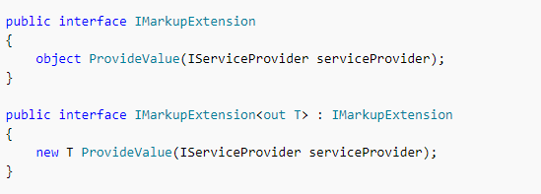
Since IMarkupExtension<T> derives from IMarkupExtension and includes the new keyword on ProvideValue, it contains both ProvideValuemethods.

Slide 25
Service Providers
By using the IServiceProvider argument to ProvideValue, XAML markup extensions can get access to helpful information about the XAML file in which they're being used.
To use the IServiceProvider argument successfully, you need to know what kind of services are available in particular contexts.
The IProvideValueTarget interface defines two properties, TargetObject and TargetProperty. When this information is obtained in the ImageResourceExtension class, TargetObject is the Image and TargetProperty is a BindableProperty object for the Source property of Image
The GetService call with an argument of typeof(IProvideValueTarget) actually returns an object of type SimpleValueTargetProvider, which is defined in the Xamarin.Forms.Xaml.Internals namespace.

Slide 26
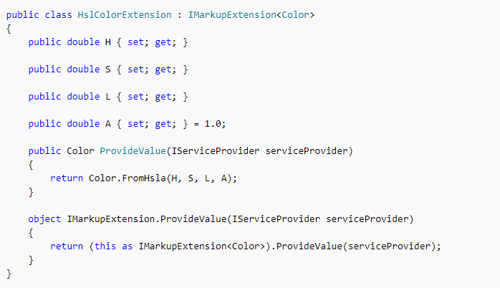
A Markup Extension for Specifying Color
We construct a Color value using hue, saturation, and luminosity components. It defines four properties for the four components of the color, including an alpha component that is initialized to 1.The class derives from IMarkupExtension<Color> to indicate a Color return value:
Because IMarkupExtension<T> derives from IMarkupExtension, the class must contain two ProvideValue methods, one that returns Color and another that returns object, but the second method can simply call the first method.

Slide 27
A Markup Extension for Accessing Bitmaps
The argument to ProvideValue is an object that implements the IServiceProvider interface, which is defined in the .NET System namespace. This interface has one member, a method named GetService with a Type argument.
The ImageResourceExtension uses IServiceProvider and GetService to obtain an IXmlLineInfoProvider object that can provide line and character information indicating where a particular error was detected.
ImageResourceExtension is helpful when a XAML file needs to access an image file stored as an embedded resource in the Portable Class Library project. It uses the Source property to call the static ImageSource.FromResource method. This method requires a fully-qualified resource name, which consists of the assembly name, the folder name, and the filename separated by periods.

Slide 28
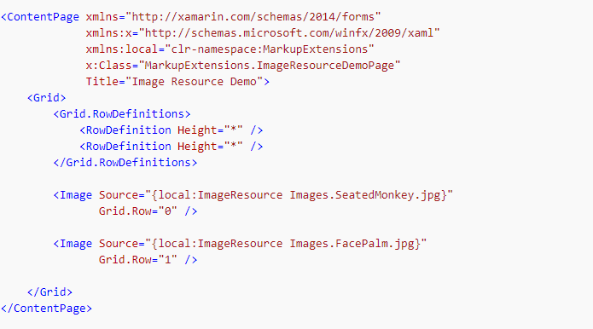


Slide 29
Passing Arguments in XAML
It's often necessary to instantiate objects with constructors that require arguments, or by calling a static creation method. This can be achieved in XAML by using the x:Arguments and x:FactoryMethod attributes:
The x:Arguments attribute is used to specify constructor arguments for a non-default constructor, or for a factory method object declaration.
The x:FactoryMethod attribute is used to specify a factory method that can be used to initialize an object.

Slide 30
Passing Constructor Arguments
Arguments can be passed to a non-default constructor using the x:Arguments attribute. Each constructor argument must be delimited within an XML element that represents the type of the argument. Xamarin.Forms supports the following elements for basic types:
x:Object
x:Boolean
x:Byte
x:Int16
x:Int32
x:Int64
x:Single
x:Double
x:Decimal
x:Char
x:String
x:TimeSpan
x:Array
x:DateTime

Slide 31
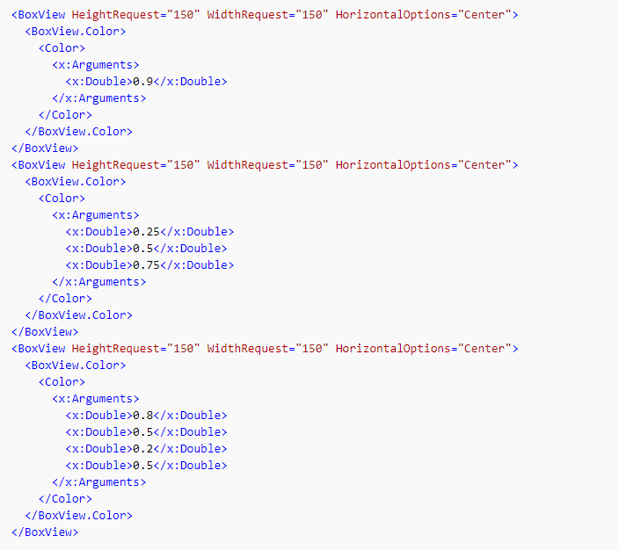
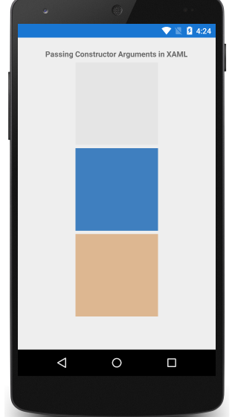
The following code example demonstrates using the x:Arguments attribute with three Color constructors

Slide 32
Calling Factory Methods
Factory methods can be called in XAML by specifying the method's name using the x:FactoryMethod attribute, and its arguments using the x:Arguments attribute. A factory method is a public static method that returns objects or values of the same type as the class or structure that defines the methods.
Things to note:
The number of elements within the x:Arguments tag, and the types of these elements, must match the arguments of the factory method being called.
The FromRgba factory method requires four Int32 parameters, which represent the red, green, blue, and alpha values, ranging from 0 to 255 respectively.
The FromHsla factory method requires four Double parameters, which represent the hue, saturation, luminosity, and alpha values, ranging from 0 to 1 respectively.
The FromHex factory method requires a String that represents the hexadecimal (A)RGB color.

Slide 33
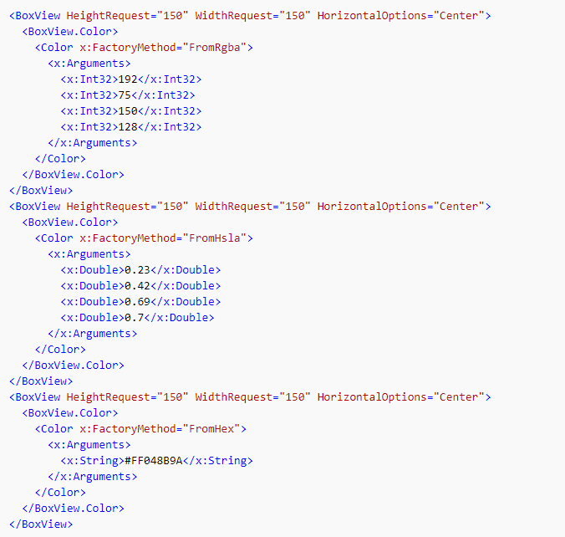
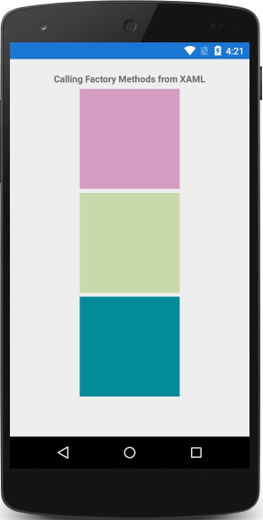

Slide 34
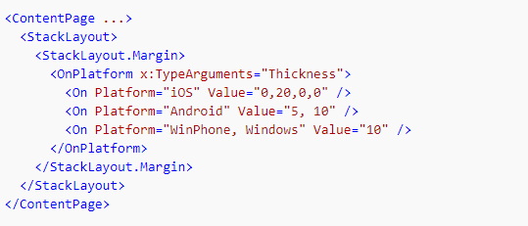
Specifying a Generic Type Argument
Generic type arguments for the constructor of a generic type can be specified using the x:TypeArguments attribute.
The OnPlatform class is a generic class and must be instantiated with an x:TypeArguments attribute that matches the target type. In the On class, the Platform attribute can accept a single string value, or multiple comma-delimited string values. In this example, the StackLayout.Margin property is set to a platform-specific Thickness.

Slide 35
Resource Dictionaries
A ResourceDictionary is a repository for resources that are used by a Xamarin.Forms application.
XAML resources are definitions of objects that can be used more than once.
A ResourceDictionary allows resources to be defined in a single location, and re-used throughout a Xamarin.Forms application
Typical resources that are stored in a ResourceDictionary include styles, control templates, data templates, colors, and converters.
In XAML, resources are defined in a ResourceDictionary and then retrieved and applied to elements by using the StaticResource markup extension.
In C#, resources are defined in a ResourceDictionary and then retrieved and applied to elements by using a string-based indexer.
Advantage: A ResourceDictionary in C#, as resources can easily be directly assigned to properties of visual elements without having to first retrieve them from a ResourceDictionary.

Slide 36
Creating and Consuming a ResourceDictionary
Things to note:
Resources can be defined in a ResourceDictionary that's attached to the Resources collection of a page or control, or to the Resources collection of the application. Choosing where to define a ResourceDictionary impacts where it can be used:
Resources in a ResourceDictionary defined at the control level can only be applied to the control and to its children.
Resources in a ResourceDictionary defined at the page level can only be applied to the page and to its children.
Resources in a ResourceDictionary defined at the application level can be applied throughout the application.

Slide 37
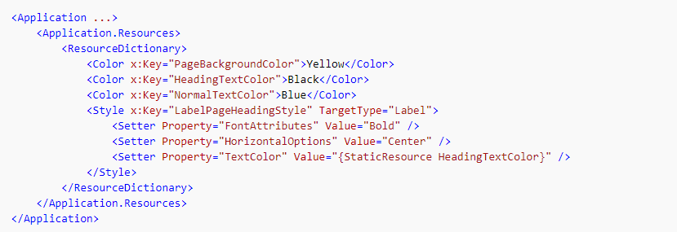
Each resource has a key that is specified using the x:Key attribute, which gives it a descriptive key in the ResourceDictionary. The key is used to retrieve a resource from the ResourceDictionary by the StaticResource markup extension

Slide 38
Reduce the Application Resource Dictionary Size
Any resources that are used throughout the application should be stored in the application's resource dictionary to avoid duplication. This will help to reduce the amount of XAML that has to be parsed throughout the application
If a resource is used by a page that's not the startup page, it should be placed in the resource dictionary for that page, therefore helping to reduce the XAML that's parsed when the application starts.

Slide 39
Styles
Styles allow the appearance of visual elements to be customized. Styles are defined for a specific type and contain values for the properties available on that type.
Different types of Styles:
Explicit Styles
Implicit Styles
Global Styles
Dynamic Styles
Device Styles

Slide 40
Creating Style
The Style class groups a collection of property values into one object that can then be applied to multiple visual element instances. This helps to reduce repetitive markup, and allows an applications appearance to be more easily changed.
Choosing where to define a Style impacts where it can be used:
Style instances defined at the control level can only be applied to the control and to its children.
Style instances defined at the page level can only be applied to the page and to its children.
Style instances defined at the application level can be applied throughout the application.
Each Style instance contains a collection of one or more Setter objects, with each Setter having a Property and a Value. The Property is the name of the bindable property of the element the style is applied to, and the Value is the value that is applied to the property.

Slide 41
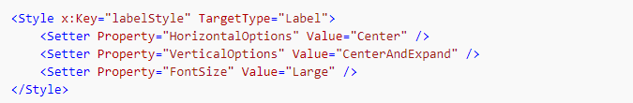
Each Style instance can be explicit, or implicit:
An explicit Style instance is defined by specifying a TargetType and an x:Key value, and by setting the target element's Style property to the x:Key reference. For more information about explicit styles, see Explicit Styles.
An implicit Style instance is defined by specifying only a TargetType. The Style instance will then automatically be applied to all elements of that type. Note that subclasses of the TargetType do not automatically have the Style applied. For more information about implicit styles, see Implicit Styles.

Slide 42
Explicit Styles
Explicit style is one that is selectively applied to controls by setting their Style properties.
A Style is made explicit by giving its declaration an x:Key attribute, and then selectively applying it to controls by setting their Style properties.
Creating Explicit Style
To declare a Style at the page level, a ResourceDictionary must be added to the page and then one or more Style declarations can be included in the ResourceDictionary.
A Style is made explicit by giving its declaration an x:Key attribute, which gives it a descriptive key in the ResourceDictionary.
Explicit styles must then be applied to specific visual elements by setting their Style properties.

Slide 43
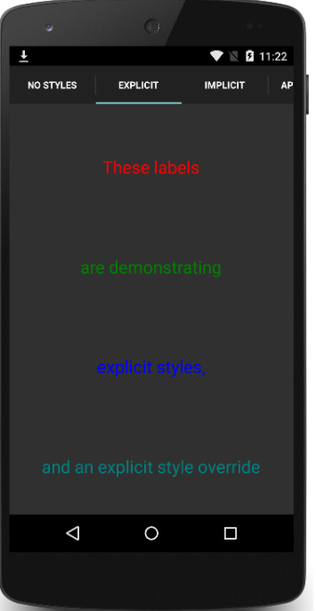
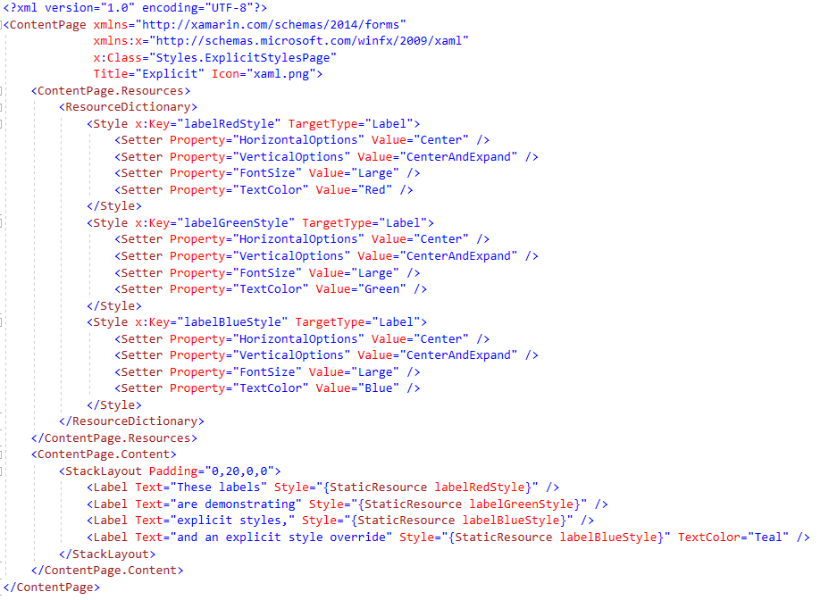
Page Level Style

Slide 44
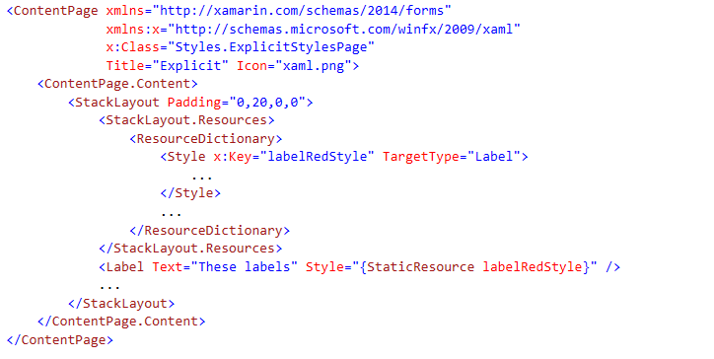
Control Level Styles

Slide 45
Implicit Styles
An implicit style is one that's used by all visual elements of the same TargetType, without requiring each control to reference the style. A Style is made implicit by not specifying an x:Key attribute. Instead, the x:Key attribute will automatically become the value of the TargetType property.
Creating an Implicit Style in XAML
To declare a Style at the page level, a ResourceDictionary must be added to the page and then one or more Style declarations can be included in the ResourceDictionary.
A Style is made implicit by not specifying an x:Key attribute.
The style will then be applied to visual elements that match the TargetType exactly, but not to elements that are derived from the TargetType value.

Slide 46
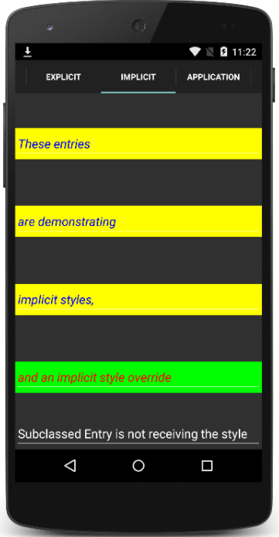
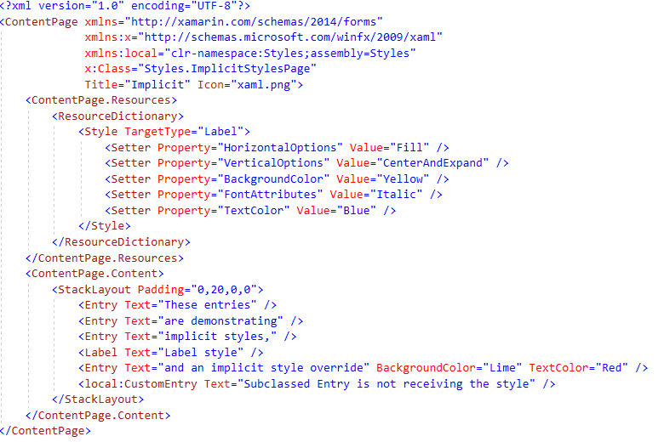
Page Level Styles

Slide 47
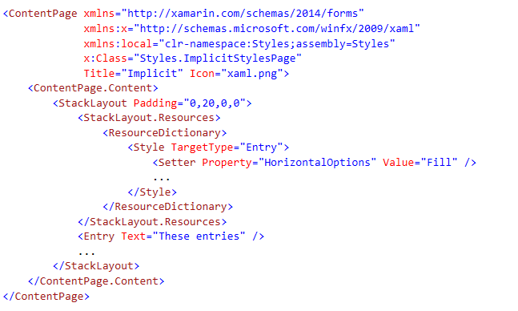
Control Level Styles

Slide 48
Global Styles
Styles can be made available globally by adding them to the application's ResourceDictionary. This helps to avoid duplication of styles across pages or controls.
Creating a Global Style in XAML
By default, all Xamarin.Forms applications created from a template use the App class to implement the Application subclass.
To declare a Style at the application level, in the application's ResourceDictionary using XAML, the default App class must be replaced with a XAML App class and associated code-behind.

Slide 49
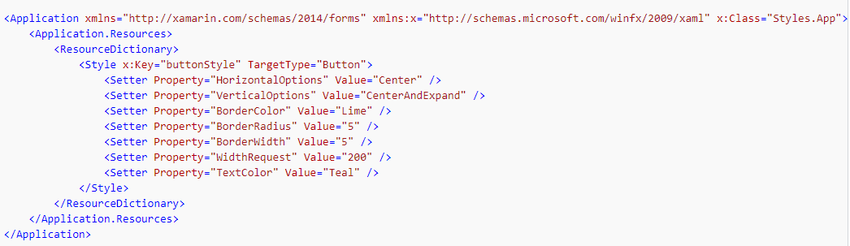
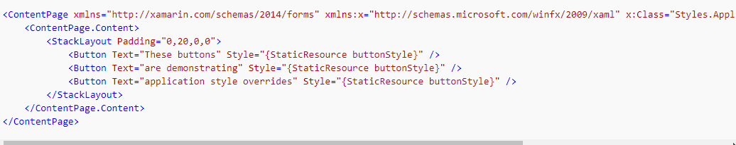
Declaring at App.Xaml
Using in any Page

Slide 50
Style Inheritance
Style inheritance is performed by setting the Style.BasedOn property to an existing Style.
In XAML, this is achieved by setting the BasedOnproperty to a StaticResource markup extension that references a previously created Style.
In C#, this is achieved by setting the BasedOn property to a Style instance.
Styles that inherit from a base style can include Setter instances for new properties, or use them to override styles from the base style.
In addition, styles that inherit from a base style must target the same type, or a type that derives from the type targeted by the base style.
Note: An implicit style can be derived from an explicit style, but an explicit style can't be derived from an implicit style.

Slide 51
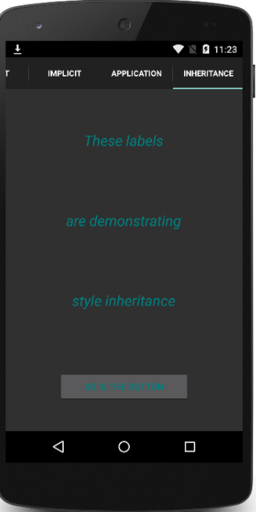
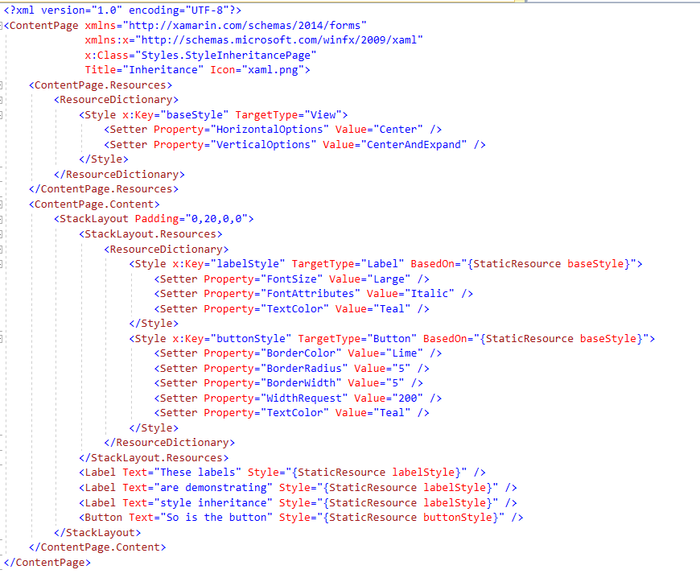

Slide 52
Dynamic Styles
Styles do not respond to property changes, and remain unchanged for the duration of an application. However, applications can respond to style changes dynamically at runtime by using dynamic resources. In addition, dynamic styles can be derived from with the BaseResourceKey property.

Slide 53
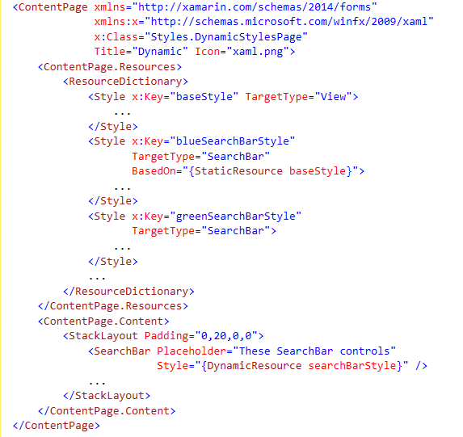
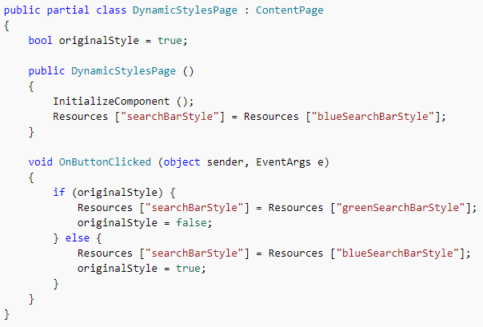

Slide 54
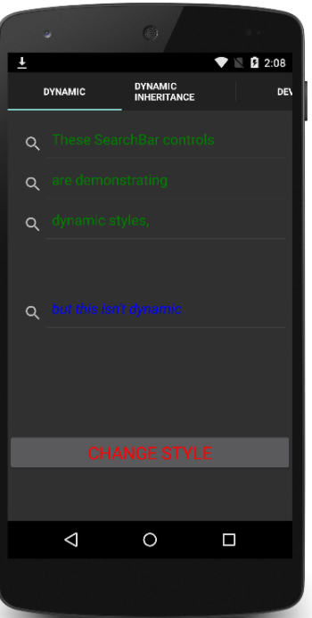
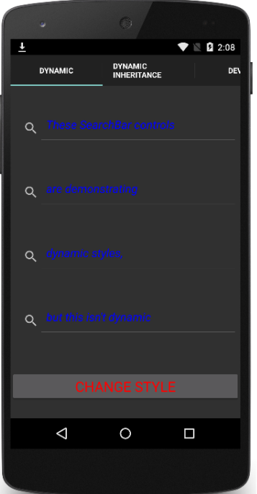
On Clicking Change Style button

Slide 55
Device Styles
Xamarin.Forms includes six dynamic styles, known as device styles, in the Devices.Styles class. All six styles can only be applied to Label instances.
The device styles are:
BodyStyle
CaptionStyle
ListItemDetailTextStyle
ListItemTextStyle
SubtitleStyle
TitleStyle

Slide 56
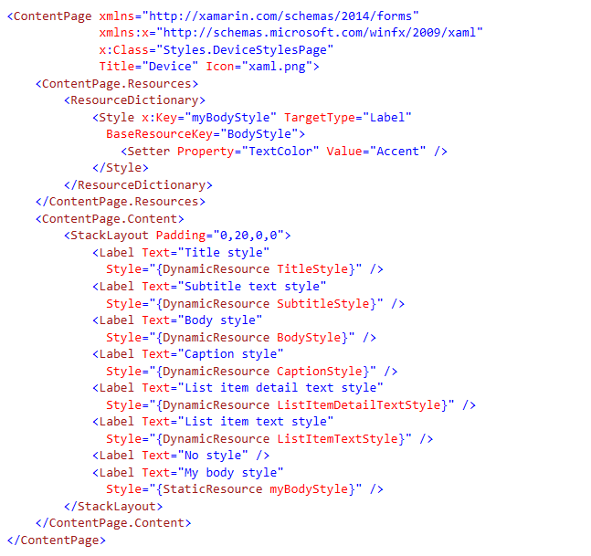
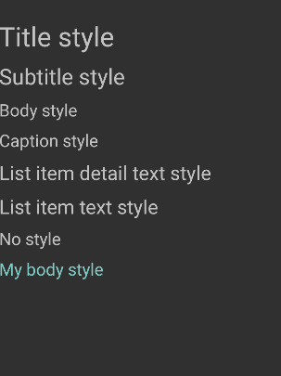
The device styles are bound to using the DynamicResource markup extension. The dynamic nature of the styles can be seen in iOS by changing the Accessibility settings for text size. The appearance of the device styles is different on each platform

Slide 57
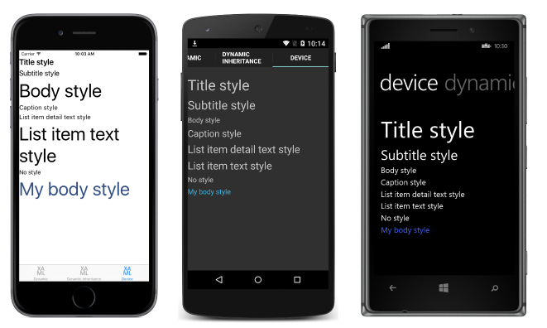
Acessibility
The device styles respect accessibility preferences, so font sizes will change as the accessibility preferences are altered on each platform. Therefore, to support accessible text, ensure that the device styles are used as the basis for any text styles within your application.

